Slide 1
Software Engineering I
Sessions 2 - 3: Project Management – Planning and Estimation
Dr. Adrian Als & Dr. Paul Walcott
Department of Computer Science, Mathematics and Physics
University of the West Indies, Cave Hill Campus
Barbados
NEXT

Slide 2
Session Objectives
On successful completion of this session a student will be able to:
  Describe some important project management terminology
  Describe some of the plans used by project managers
  Describe software production difficulties
  Explain the duties and responsibilities of a project manager

Slide 3
Session Objectives
  Explain the software planning process
  Prepare a software project management plan
    This plan should include estimates of size and effort, a project schedule, the resource allocation; configuration control; change management; and risk management
  Analyse project risk using a risk management process

Slide 4
Introduction
In this session we will be examining the roles and responsibilities of the software project manager.
Before embarking on this journey however there is some important terminology that we must understand.

Slide 5
Project Management Terminology
(Schach 2005)
Work done:
  Project function – The work “that continues throughout a project” (Schach 2005). This work does not relate to any specific phase of development.
    For example, a project manager will monitor a project throughout the project; and quality control is a continuous process.
Notes:
Note that a project function takes a global view of work done on the project whereas an activity is work related to a specific phase in the development of the project.

Slide 6
Project Management Terminology Cont’d
Work done cont’d:
  An activity is a major unit of work that has identifiable beginning and ending states, consumes resources (e.g. computer time), and produces work products (e.g. budget, source code and a user manual).
  An activity is work relating to a specific phase of the project and may consist of a number of tasks (where a task is the smallest unit of work)
Notes:
Note that a project function takes a global view of work done on the project whereas an activity is work related to a specific phase in the development of the project.

Slide 7
Project Management Terminology Cont’d
Work done cont’d:
  Creating a specification document is an activity and the associated work product is the specification document.
  A task associated with this activity might be to create a table of contents for the document
Notes:
Note that a project function takes a global view of work done on the project whereas an activity is work related to a specific phase in the development of the project.

Slide 8
Project Management Terminology Cont’d
Milestone – a date set on which a work product (/activity) is to be completed.
  An example of a milestone is the end of development – when coding has been completed and is awaiting review
  In order to determine when a milestone has been reached, it must pass a series of reviews performed by fellow team members and/or the client.
Notes:
At each milestones (e.g. a report) should be produced and presented to management. The report need not be large, but should represent the end of a distinct, logical stage in the project. Indefinite milestones such as “Coding is 80% complete” which are virtually impossible to validate are useless for project management.

Slide 9
Project Management Terminology Cont’d
Baseline – a reviewed and agreed upon work product.
  For example an inspected requirements document that has been reviewed and accepted by the client
Notes:
At each milestones (e.g. a report) should be produced and presented to management. The report need not be large, but should represent the end of a distinct, logical stage in the project. Indefinite milestones such as “Coding is 80% complete” which are virtually impossible to validate are useless for project management.

Slide 10
Project Management Terminology Cont’d
Deliverable – A project result that is delivered to the customer (internal or external). It is usually delivered at the end of some major project phase (e.g. specifications, or design).
  For example, releasing Version 6.1 of the Inventory Control product to the customer
Notes:
Deliverables are usually milestones, but milestones need not be deliverables. For example, a milestone can be an internal project result which is used by the project manager to check progress, but not delivered to the client.

Slide 11
Project Management Terminology Cont’d
Work package – defines the work product, staffing requirements, duration, resources, names of the people responsible and acceptance criteria for a work product.
  For example: Specification Document Responsible for authoring: Sue Smith
  Time to complete: 1 week (Feb 15-19)
  Acceptance criteria: Must pass inspection
Notes:
Deliverables are usually milestones, but milestones need not be deliverables. For example, a milestone can be an internal project result which is used by the project manager to check progress, but not delivered to the client.

Slide 12
Software Project Management
(Sommerville 2004)

Slide 13
Why was software project management necessary?
Failure of many large software projects in the 1960s and 1970s was the first indication that there were difficulties in software management.
Software was being delivered late, over budget and contained functional flaws (Bauer 1973)
Notes:
The failure of many large software projects in the 1960s and 1970s was the first indication of difficulties of software management. This was in the era of the software crisis where the product was delivered late, over budget and was often flawed. The root cause was not the incompetence of the programmers or the managers but the approach adopted by the management in tackling the oftentimes mammoth objective.
Recall that SE is the combination of two disciplines, Engineering and all the aspects of software production. The engineering approach introduced management, (a structured approach) which was a direct response to the software crisis.

Slide 14
Activity
Read page 474-475 of Bauer (1973) and discuss why the software crisis occurred.

Slide 15
Why was software project management necessary (Cont’d)?
This software crisis resulted from inadequacies in the management process due to inexperience and not because of incompetence on the part of the programmer or management.
Notes:
The failure of many large software projects in the 1960s and 1970s was the first indication of difficulties of software management. This was in the era of the software crisis where the product was delivered late, over budget and was often flawed. The root cause was not the incompetence of the programmers or the managers but the approach adopted by the management in tackling the oftentimes mammoth objective.
Recall that SE is the combination of two disciplines, Engineering and all the aspects of software production. The engineering approach introduced management, (a structured approach) which was a direct response to the software crisis.

Slide 16
What are the responsibilities of a software project manager?
The software project manager is responsible for:
  Proposal writing
  Planning and scheduling the project development
  Monitoring the project progress and making sure that development is on schedule and within budget.
Notes:
The need for management is an important distinction between professional software development and amateur programming.
The project manager must work within the time and budget constraints to deliver a high quality project. Good management does not guarantee a successful project. However, bad management usually results in failure.

Slide 17
What are the responsibilities of a software project manager?
  Personnel selection and evaluation
  Report writing and presentations
  Supervising the work to ensure that quality standards are maintained
  Risk management
Notes:
The need for management is an important distinction between professional software development and amateur programming.
The project manager must work within the time and budget constraints to deliver a high quality project. Good management does not guarantee a successful project. However, bad management usually results in failure.

Slide 18
Proposal writing is the responsibility of the project manager
Proposal writing is the first stage of a project.
The proposal document describes the objectives of the project, how it will be carried out, as well as the cost and schedule estimates.
The document may also justify why the project contract should be awarded to a particular organisation or team.
Notes:
Proposal writing is the first stage of the project. The proposal document describes the objectives of the project, how it will be carried out as well as the cost and schedule estimates. In addition, the document may justify why the project contract should be awarded to a particular organisation or team.

Slide 19
Activity
Discuss the project proposal artefact presented in class.

Slide 20
Project planning is the responsibility of the project manager
Project planning is concerned with the identification of the activities, milestones and deliverables produced by a project.
A plan must then be drawn up to guide the project towards its goals.
Cost estimation, a related activity, is also undertaken during this stage.
Notes:
Project planning is concerned with identifying the activities, milestones and deliverables produced by a project. A plan must then be drawn up to guide the development towards the project goals. Cost estimation, a related activity, is also undertaken during this stage.
In essence, cost estimation is concerned with estimating the resources required to realise the project plan.

Slide 21
Activity
Present an example of a real world project plan

Slide 22
Project planning is the responsibility of the project manager cont’d
What are some of the difficulties associated with planning a project?
The development time for a large software project may be several years and it is unlikely that the client’s requirements will remain static.
As the objectives for the software change to meet its new specifications the original software management plan will have to change accordingly.
Notes:
The development time for a large software project may be several years and it is unlikely that the client’s requirements will remain static. As the objectives for the software change to meet its new specifications the original software management plan will have to change accordingly. Management may decide to stop software development or to change the plan to accommodate the new specifications.

Slide 23
Project planning is the responsibility of the project manager cont’d
Management may decide to stop software development or to change the plan to accommodate the new specifications.
Notes:
The development time for a large software project may be several years and it is unlikely that the client’s requirements will remain static. As the objectives for the software change to meet its new specifications the original software management plan will have to change accordingly. Management may decide to stop software development or to change the plan to accommodate the new specifications.

Slide 24
Project monitoring is the responsibility of the project manager
Monitoring is a continuous project activity that requires the project manager to keep track of the progress of the project.
Comparisons between actual and planned estimates for progress and costs are used as the basis for monitoring the project schedules.
Notes:
To gauge quality, efficiency and if schedule is being maintained
Project monitoring is a continuous project activity and requires the project manager to keep track of the progress of the project. Comparisons between actual and planned estimates for progress and costs are used as the basis for monitoring the project schedules.
Informal monitoring (/reviews) can often predict potential project problems as they may reveal difficulties as they occur. This avoids potential delays caused by having to wait on a scheduled meeting. Such meetings can occurs daily between the project manager and (key members of ) the project staff [less rigid]
Formal reviews are also part of the project monitoring. These are primarily concerned with reviewing overall progress and technical development of the project.

Slide 25
Activity
Present the project wellness and completeness metrics used to monitor a financial software project

Slide 26
Project monitoring is the responsibility of the project manager cont’d
Informal monitoring (/reviews) can often predict potential project problems as they may reveal difficulties as they occur.
Formal reviews can also be used for project monitoring. These are primarily concerned with reviewing overall progress and technical development of the project.
Notes:
To gauge quality, efficiency and if schedule is being maintained
Project monitoring is a continuous project activity and requires the project manager to keep track of the progress of the project. Comparisons between actual and planned estimates for progress and costs are used as the basis for monitoring the project schedules.
Informal monitoring (/reviews) can often predict potential project problems as they may reveal difficulties as they occur. This avoids potential delays caused by having to wait on a scheduled meeting. Such meetings can occurs daily between the project manager and (key members of ) the project staff [less rigid]
Formal reviews are also part of the project monitoring. These are primarily concerned with reviewing overall progress and technical development of the project.

Slide 27
Personnel selection is the responsibility of the project manager
The manager is responsible for the team selection and evaluation of personnel.
The aim is to create a team that has:
  the right mix of personalities
  good communication
  highly motivated (positive attitude)
Ideally, each team member will have the requisite skill level and experience.
Notes:
Creating the right environment
Personnel selection – the manager is responsible for team selection and evaluation. Ideally, skilled staff with the appropriate experience will be available to work in the project. However in most cases the manager will have to settle for less that an ideal project because:
a.The project budget may not cover the use of highly paid staff. Less experienced, less well-paid staff may have to be used.
b.Staff with the appropriate experience many not be available either within the organisation or externally. It may be impossible to recruit new staff to the project. Within the organisation, the best people may already be allocated to the other projects.
c.The organisation may wish to develop the skills of the employees. Inexperienced staff may be assigned to a project to learn and to gain experience.
given these staffing constraints, it is advisable that the project manager ensure that at least one member of the project team has experience with the type of system being developed.

Slide 28
Personnel selection is the responsibility of the project manager cont’d
Difficulties in selecting personnel
In most cases the manager will have to settle for less that an ideal project team because:
  The project budget may not cover the use of highly paid staff. As a result, less experienced, less well-paid staff may have to be used.
Notes:
Compromise
In most cases the manager will have to settle for less that an ideal project because:
The project budget may not cover the use of highly paid staff. Less experienced, less well-paid staff may have to be used.
Staff with the appropriate experience many not be available either within the organisation or externally. It may be impossible to recruit new staff to the project. Within the organisation, the best people may already be allocated to the other projects.
The organisation may wish to develop the skills of the employees. Inexperienced staff may be assigned to a project to learn and to gain experience.

Slide 29
Personnel selection is the responsibility of the project manager cont’d
Difficulties in selecting personnel cont’d
  Staff with the appropriate experience may not be available, either within the organisation or externally.
  It may be impossible to recruit new staff to the project.
Notes:
Compromise
In most cases the manager will have to settle for less that an ideal project because:
The project budget may not cover the use of highly paid staff. Less experienced, less well-paid staff may have to be used.
Staff with the appropriate experience may not be available either within the organisation or externally. It may be impossible to recruit new staff to the project. Within the organisation, the best people may already be allocated to the other projects.
The organisation may wish to develop the skills of the employees. Inexperienced staff may be assigned to a project to learn and to gain experience.

Slide 30
Personnel selection is the responsibility of the project manager cont’d
Difficulties in selecting personnel cont’d
Within the organisation, the best people may already be allocated to other projects.
The organisation may wish to develop the skills of the employees and as a result assign inexperienced staff to the project
Notes:
Compromise
In most cases the manager will have to settle for less that an ideal project because:
The project budget may not cover the use of highly paid staff. Less experienced, less well-paid staff may have to be used.
Staff with the appropriate experience may not be available either within the organisation or externally. It may be impossible to recruit new staff to the project. Within the organisation, the best people may already be allocated to the other projects.
The organisation may wish to develop the skills of the employees. Inexperienced staff may be assigned to a project to learn and to gain experience.

Slide 31
Reflective Question
What happens if a key member of a team leaves during a critical phase of the project?

Slide 32
Reflective Question
If you had to select a team how would you do it?

Slide 33
Report writing and presentations are the responsibility of the project manager
The project manager is responsible for reporting on the project to both the client and the contractor organisations.
  He/she must write concise, coherent documents, which abstract from detailed project reports
  These documents are then presented during the progress review meetings.
Notes:
Report writing and presentations – the project manager has the responsibility for reporting on the project to both the client and the contractor organisations. Consequently, he/she must write concise, coherent documents, which abstract from detailed project reports. These documents are then presented during the process review meetings. In essence, the project manager should be able to communicate effectively both orally and in writing.

Slide 34
Report writing and presentations are the responsibility of the project manager
In essence, the project manager should be effective at both written and oral communication.
Notes:
Report writing and presentations – the project manager has the responsibility for reporting on the project to both the client and the contractor organisations. Consequently, he/she must write concise, coherent documents, which abstract from detailed project reports. These documents are then presented during the process review meetings. In essence, the project manager should be able to communicate effectively both orally and in writing.

Slide 35
Software planning
(Schach 2005)

Slide 36
What does the software project management plan address?
The software project management plan addresses the work to be done, the required resources (people to develop the software; the hardware; and support software, for example operating systems and text editors) and the financing.
Resource consumption
k
Time (t)
Figure 1 - (Rayleigh) Graph of resource consumption against time
Notes:
The Software Project Management plan addresses the three concerns that are essential for a successful project:
1.The work to be done
2.The resources with which to do it. The major resources are:
a. People to develop the software
b. Hardware to run the software
c. Support software (e.g. OS’s, text editors, etc…)
3. The money to pay for it

Slide 37
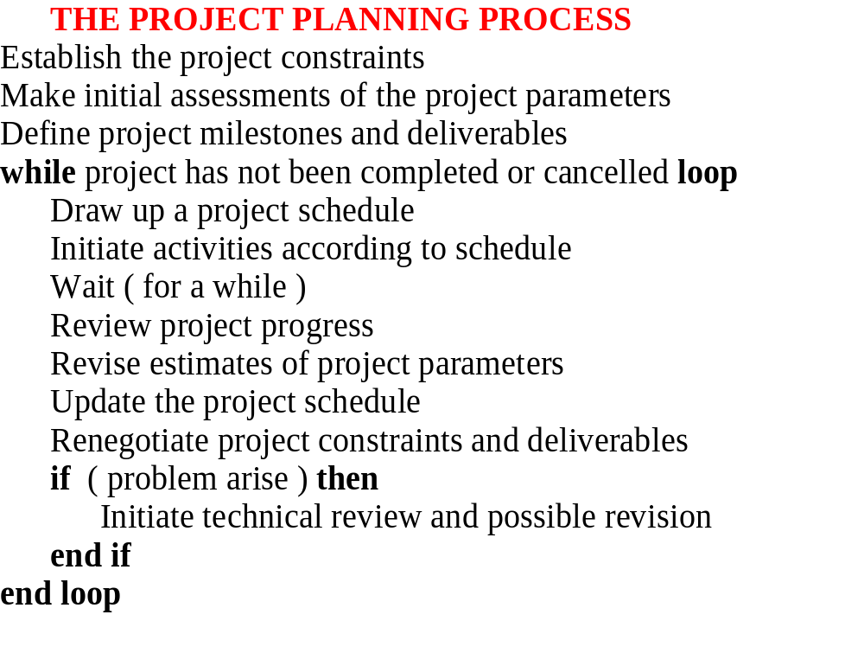

Slide 38
The software project planning process
The planning process comprises four main phases:
Defining the problem
Cost-benefit analysis
Determining the
optimal
solution strategy
Developing the
software project
management plan
Notes:
These stages/phases are very similar to the process that process undertaken when undertaking a “problem solving exercise” as per COMP1105/COMP1115.
The cost-benefit analysis is essentially a feasibility guide and should also present alternative solutions.

Slide 39
Defining the problem
The problem must be clearly stated.
The user requirements are concretely expressed in a specifications document.
The specification document should be in a form that the client (and the prospective users) can understand.
Notes:
The problem is clearly stated – the preliminary concept is refined until there is no doubt about the product is supposed to do. Thus, in the democratic approach this suggests that there must be unanimity among the team members. Once the development team understands what the product should do, the users requirements are concretely expressed in a specifications document. This document should be in a form that the client (and the perspective users) can understand. Note that to resolve any ambiguities with the specifications document one may use prototyping techniques. In addition, the specifications document also addresses the constraints which the product must satisfy.
Lets take an example of a client wanting to have a software product developed to change from a manually based to a computerised based system:
The team must determine why the current system is unsatisfactory, and what the new product must be able to do. This is handled during the requirements phase
Once the development team understands what the product should do, the user’s requirements are concretely expressed in a specifications document.
This document must be in a form that the client and his/her staff can easily understand. In some cases, prototyping can be used to resolve any difficulties in the regard.

Slide 40
Defining the problem cont’d
This document addresses:
  Cost
  Time deadlines
  Parallel conversions (i.e. implementing a manual and computerised system in parallel, e.g. database system)
  Portability

Slide 41
Defining the problem cont’d
  Reliability: some products have to be run 24/hrs a day e.g. a patients monitoring system
  Rapid response time
  Acceptance criteria - both the client and developer should supply a series of tests which the product must pass before being accepted.

Slide 42
Determining the optimal solution strategy
A solution strategy is a general approach to building the product, for example the use of an online database versus the use of standard flat files and batch processing
The various solution strategies are evaluated in light of the constraints, and, if necessary, modifications are made.
Notes:
2. The best/most feasible solution is chosen in light of resources and constraints.

Slide 43
Determining the optimal solution strategy cont’d
Prototyping can help determine whether a specific solution will satisfy the client’s constraints.
Notes:
2. The best/most feasible solution is chosen in light of resources and constraints.

Slide 44
Cost Benefit Analysis
This is a technique used to compare estimated future benefits against projected future costs.
For example consider the following hypothetical example of a utility company planning to computerise its manual billing system.
Notes:
Cost Benefit Analysis
This is a technique of comparing estimated future benefits against projected future costs.Example:
Consider the following hypothetical example of a utility company planning to computerise its manual billing system.
Old system:
• Manual, Billing done by 50 clerks who mailed bills every 2 months
Proposed new system:
• Computerised, Company must purchase/lease software and hardware
Advantages of new system
• Bills to be mailed monthly instead of every two months. This will improve the company’s cash flow
• 50 billing clerks to be replaced by 10 data capture clerks
Disadvantages of new system
• Complete data processing department must be set up with well-paid computer professionals.
Over a 5 yr.. period, financial benefits were estimated as follows:
1.Salary savings estimated as $1,600,000, 2. Improved cash flow projected to be $900,000
Total benefit: $2,500,000

Slide 45
Cost Benefit Analysis Cont’d
On the old system, billing was done manually by 50 clerks who mailed bills every two months.
The proposed system is computerised and will require the company to purchase/lease software and hardware.

Slide 46
Cost Benefit Analysis Cont’d
Advantages of new system
Bills to be mailed monthly instead of every two months. This will improve the company’s cash flow
50 billing clerks to be replaced by 10 data capture clerks
Disadvantages of new system
Complete data processing department must be set up with well-paid computer professionals.
Notes:
Over a 5 yr. period, cost were estimated as follows:
Cost of hardware and software: $1,3000,000
2. 1 yr. conversion cost: $400,000
3. Cost of educating customers about new system: $130,000
Total costs: $670,000
Estimated net benefit = $1,830,000.
Hence supports the decision to computerise.

Slide 47
Cost Benefit Analysis Cont’d
Over a 5 yr. period, financial benefits were estimated as follows:
1. Salary savings estimated as $1,600,000
2. Improved cash flow projected to be $900,000
Total benefit: $2,500,000
Notes:
Over a 5 yr. period, cost were estimated as follows:
Cost of hardware and software: $1,3000,000
2. 1 yr. conversion cost: $400,000
3. Cost of educating customers about new system: $130,000
Total costs: $670,000
Estimated net benefit = $1,830,000.
Hence supports the decision to computerise.

Slide 48
Cost Benefit Analysis Cont’d
Over a 5 yr. period, cost were estimated as follows:
Cost of hardware and software: $1,300,000
1 yr. conversion cost: $400,000
Cost of educating customers about new system: $130,000
Total costs: $1,830,000.
Estimated net benefit = $2,500,000 - $1,830,000 = $670,000.
This supports the decision to computerise.

Slide 49
Software project management plan
The plan should address the various work units, the estimated resources required and the budget.
It should also provide a detailed timetable showing: what is to be done and when, what resources are required, and what it will cost.
Notes:
At this stage, an actual plan is drawn up. This plan should address:
•The various work units
•The estimated resources required and the budget
•A detailed timetable showing:
1.what is to be done and when
2.what resources are required
3.what it will cost
The plan should also take into account the issues of software quality (see notes on validation and verification).

Slide 50
Software project management plan: Planning Scope
A pivotal part of planning focuses on estimating the:
  Time
  Cost
  Size of the product
Notes:
A pivotal part of planning focuses on estimating the time, cost and the size of the product.
Cost refers to the budget, which is an integral part of the software project management plans. The client wants to know how much to pay for the product before development commences. If the team underestimates the actual cost then building the product will cause the client to lose money. Conversely, if the team overestimates, then the client may decide not to have the product built. His decision is primarily being based on the results of a cost-benefit analysis.

Slide 51
Software project management plan: Time
Time - Refers to when the product will be delivered.
  If the development organisation is unable to keep its schedule then:
    potential penalty clauses may be invoked
    the organisation’s credibility may suffer.
  If the developers overestimate the time then:
    the client may choose to go elsewhere.
Notes:
The human factor is primarily responsible for the difficult in estimating the time as team members may work at different speeds. In addition, critical staff members may resign before the project is completed.

Slide 52
Software project management plan: Cost
Refers to the budget, which is an integral part of the software project management plan.
The client wants to know how much to pay for the product before development commences.
Notes:
Cost refers to the budget, which is an integral part of the software project management plan. The client wants to know how much to pay for the product before development commences. If the team underestimates the actual cost then building the product will cause the client to lose money. Conversely, if the team overestimates, then the client may decide not to have the product built. His decision is primarily being based on the results of a cost-benefit analysis.

Slide 53
Software project management plan: Cost Cont’d
If the team underestimates the actual cost then building the product will cause the client to lose money.
If the team overestimates, then the client may decide not to have the product built.
The final decision is primarily based on the results of a cost-benefit analysis.
Notes:
Cost refers to the budget, which is an integral part of the software project management plan. The client wants to know how much to pay for the product before development commences. If the team underestimates the actual cost then building the product will cause the client to lose money. Conversely, if the team overestimates, then the client may decide not to have the product built. His decision is primarily being based on the results of a cost-benefit analysis.

Slide 54
Software project management plan: Size
A measurement of size is lines of code (LOC), or thousand delivered source instructions (KDSI).
LOC is more unreliable because:
  The number of LOC can only be determined when the product is finished.
  Language implementation may be different (e.g. Cobol vs. C).
Notes:
Recall that the size of the product may be measured in lines of code (LOC), and thousand delivered source instructions (KDSI). The former method is more unreliable as:
1.The number of LOC can only be determined when the product is finished.
2.Language implementation may be different (e.g. Cobol vs. C).
3.Ambiguity in measuring LOC. (i.e. what does one consider, executable code, comments, data definitions?)
4.Not all code written is delivered to the clients
5.Creation of source code is a small part of the total software development. The major phases cannot be expressed as a function of LOC.

Slide 55
Software project management plan: Size Cont’d
  Ambiguity in measuring LOC. (i.e. what does one consider, executable code, comments, data definitions?)
  Not all code written is delivered to the clients
  Creation of source code is a small part of the total software development. The major phases cannot be expressed as a function of LOC.
Notes:
Recall that the size of the product may be measured in lines of code (LOC), and thousand delivered source instructions (KDSI). The former method is more unreliable as:
1.The number of LOC can only be determined when the product is finished.
2.Language implementation may be different (e.g. Cobol vs. C).
3.Ambiguity in measuring LOC. (i.e. what does one consider, executable code, comments, data definitions?)
4.Not all code written is delivered to the clients
5.Creation of source code is a small part of the total software development. The major phases cannot be expressed as a function of LOC.

Slide 56
Software project management plan: Size Cont’d
Note: KDSI refers to 1,000 lines of newly developed source code (http://www.javvin.com/softwareglossary/DSI.html)
Notes:
Recall that the size of the product may be measured in lines of code (LOC), and thousand delivered source instructions (KDSI). The former method is more unreliable as:
1.The number of LOC can only be determined when the product is finished.
2.Language implementation may be different (e.g. Cobol vs. C).
3.Ambiguity in measuring LOC. (i.e. what does one consider, executable code, comments, data definitions?)
4.Not all code written is delivered to the clients
5.Creation of source code is a small part of the total software development. The major phases cannot be expressed as a function of LOC.

Slide 57
Software project management plan: What does the plan contain?
  Introduction – Describes the objectives of the project and sets out the constraints (e.g. budget and time) which affect the project management.
  Project organisation – Describes the way in which the development team is organised, the people involved and their roles in the team
Notes:
Introduction – Describes the objectives of the project and sets out the constraints (e.g. budget, time, etc.) with affect the project management.
Project organisation – Describes the way in which the development team is organised, the people involved and their roles in the team
Risk analysis – Describes the possible project risks, the likelihood of these risks arising and the risk reduction strategies that are proposed.
Hardware and software resource requirements – Describes the hardware and support software required to carry out the development. If the hardware has to be bought then estimates of the prices and the delivery schedule should be included.
Work breakdown – Describes the breakdown of the project into activities and identifies the milestones and deliverables associated with each activity.
Project schedule – Describes the dependencies between activities, the estimated time required to reach each milestone and the allocation of people to activities.
Monitoring and reporting mechanisms – Describes the management reports which should be produced, when they should be produced and the project monitoring mechanisms to be used.

Slide 58
Software project management plan: What does the plan contain cont’d?
  Risk analysis – Describes the possible project risks, the likelihood of these risks arising and the risk reduction strategies that are proposed.
Notes:
Introduction – Describes the objectives of the project and sets out the constraints (e.g. budget, time, etc.) with affect the project management.
Project organisation – Describes the way in which the development team is organised, the people involved and their roles in the team
Risk analysis – Describes the possible project risks, the likelihood of these risks arising and the risk reduction strategies that are proposed.
Hardware and software resource requirements – Describes the hardware and support software required to carry out the development. If the hardware has to be bought then estimates of the prices and the delivery schedule should be included.
Work breakdown – Describes the breakdown of the project into activities and identifies the milestones and deliverables associated with each activity.
Project schedule – Describes the dependencies between activities, the estimated time required to reach each milestone and the allocation of people to activities.
Monitoring and reporting mechanisms – Describes the management reports which should be produced, when they should be produced and the project monitoring mechanisms to be used.

Slide 59
Software project management plan: What does the plan contain cont’d?
Hardware and software resource requirements – Describes the hardware and support software required to carry out the development. If the hardware has to be bought then estimates of the prices and the delivery schedule should be included.

Slide 60
Software project management plan: What does the plan contain cont’d?
Work breakdown – Describes the breakdown of the project into activities and identifies the milestones and deliverables associated with each activity.

Slide 61
Software project management plan: What does the plan contain cont’d?
Project schedule – Describes the dependencies between activities, the estimated time required to reach each milestone and the allocation of people to activities.

Slide 62
Software project management plan: What does the plan contain cont’d?
Monitoring and reporting mechanisms – Describes the management reports which should be produced, when they should be produced and the project monitoring mechanisms to be used.

Slide 63
What are some of the other plans a project manager creates?
The project manager is also responsible for developing other plans along with the project plan. These other plans include:
  Quality plan – Describes the quality procedures and standards that will be used in a project.
Notes:
Recall, Effective management depends on thoroughly planning the progress of the project. The project manager must anticipate problems which might arise and prepare tentative solutions to those problems. At the start of the project an initial plan is drawn up, using the currently known information, and used as a guideline. This plan then evolves with the project. Recall that the planning process starts with an assessment of the constraints (required delivery date, staff availability, and overall budget etc…) affecting the project. This is carried out in conjunction with an estimation of project parameters such as its structure, size and distribution of functions. The progress milestones and deliverables are then defined. The process then enters a loop. A schedule of the project is drawn up and the activities defined in the schedule are initiates or given permission to continue. After a given period of time (usually 2-3 weeks), progress is reviewed and discrepancies noted. Because initial estimates of project parameters are tentative, the plan will always need to be modified.
As more information is made available the plan may need to be revised; any resulting delays will require a renegotiation of the project constraints and deliverables with the customer. If unsuccessful then a project technical review may be held to try to find an alternative approach to the development with falls within the constraints and meets the schedule.
Quality plan => Documentation standards: Identify each document, presentation (house style), update procedures. Set out required product qualities and determine how they are assessed. Needs risk management as well.
Bad management = always results in an unsuccessful project; good management does not guarantee a successful project. Good management is key and so to is proper planning.

Slide 64
What are some of the other plans a project manager creates cont’d?
  Validation plan – Describes the approach, resources and schedule used for system validation.
  Configuration management plan – Predicts the configuration management procedures (how to configure the system for use) and structures to be used.
Notes:
Recall, Effective management depends on thoroughly planning the progress of the project. The project manager must anticipate problems which might arise and prepare tentative solutions to those problems. At the start of the project an initial plan is drawn up, using the currently known information, and used as a guideline. This plan then evolves with the project. Recall that the planning process starts with an assessment of the constraints (required delivery date, staff availability, and overall budget etc…) affecting the project. This is carried out in conjunction with an estimation of project parameters such as its structure, size and distribution of functions. The progress milestones and deliverables are then defined. The process then enters a loop. A schedule of the project is drawn up and the activities defined in the schedule are initiates or given permission to continue. After a given period of time (usually 2-3 weeks), progress is reviewed and discrepancies noted. Because initial estimates of project parameters are tentative, the plan will always need to be modified.
As more information is made available the plan may need to be revised; any resulting delays will require a renegotiation of the project constraints and deliverables with the customer. If unsuccessful then a project technical review may be held to try to find an alternative approach to the development with falls within the constraints and meets the schedule.
Quality plan => Documentation standards: Identify each document, presentation (house style), update procedures. Set out required product qualities and determine how they are assessed. Needs risk management as well.
Bad management = always results in an unsuccessful project; good management does not guarantee a successful project. Good management is key and so to is proper planning.

Slide 65
What are some of the other plans a project manager creates cont’d?
  Maintenance plan – Predicts the maintenance requirements of system maintenance costs and effort required.
  Staff development plan – Describes how the skills and experience of the project team members will be developed.
Notes:
Note that in some organisations, the project plan may be a single comprehensive document including all the different types of plans. Alternatively, the project plan focuses solely on the development process and refers to the other types of plans. In this case these other plans are contained in a separate document. Assuming this to be the case, then the project plan usually includes the following sections:
Configuration management plan aids in managing the evolution of a product.

Slide 66
How do you schedule a project?
It involves the decomposition of the total work involved in the project into activities and judging the time required to complete these activities.
It requires the coordinating of parallel activities so that the workforce is used optimally. This is to avoid the situation where the whole project is delayed because a critical task is unfinished.

Slide 67
How do you schedule a project cont’d?
This is a tricky and demanding task to tackle because of Murphy’s Law.
The schedule should always be revised (/updated) to reflect any new projected target dates as more information regarding the project becomes available.
  For example, a developer took twice as long performing a coding activity

Slide 68
How do you schedule a project cont’d?
Experience from scheduling other projects is handy, but should not be used as the basis for scheduling a given projects unless it is similar to the previous projects.
  This is one of the big problems with software engineering; projects tend not to be similar

Slide 69
What are some scheduling hazards?
These include:
Underestimation of resources needed
Staff falling ill or leaving the project
Hardware failures
Notes:
Building a house and having all the materials for the roof and the interior but too few bricks
Student registration system w/o sufficient resources
Ordering resources (counter tops) from overseas. The availability of these resources and the timely delivery depends on whether you are in a 1st or 3rd world country.

Slide 70
Project Scheduling – Graphical Notations I
When creating a schedule the project manager begins with a set of tasks
Effort, duration and start date are then estimated for each task.
This information may then be represented in a tabular form using a Gantt chart

Slide 71
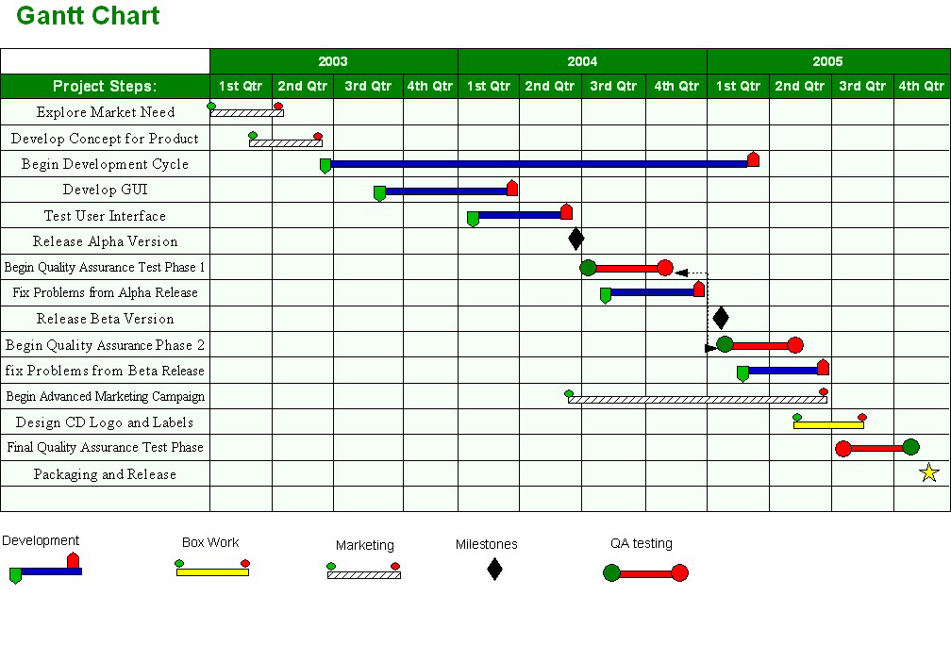
The Gantt Chart
Notes:
Essentially, a Gantt chart is a matrix, which lists on the vertical axis all the tasks to be performed. Each row contains a single task identification, which usually consists of a number and name. The horizontal axis is headed by columns indicating estimated task duration, skill level needed to perform the task, and the name of the person assigned to the task, followed by one column for each period in the project's duration. Each period may be expressed in hours, days, weeks, months, and other time units. In some cases it may be necessary to label the period columns as period 1, period 2, and so on.
The graphics portion of the Gantt chart consists of a horizontal bar for each task connecting the period start and period ending columns. A set of markers is usually used to indicate estimated and actual start and end. Each bar on a separate line, and the name of each person assigned to the task is on a separate line. In many cases when this type of project plan is used, a blank row is left between tasks. When the project is under way, this row is used to indicate progress, indicated by a second bar, which starts in the period column when the task is actually started and continues until the task is actually completed. Comparison between estimated start and end and actual start and end should indicate project status on a task-by-task basis.
NB: MS Project auto-updates

Slide 72
Project Scheduling – Graphical Notations II
The project schedule may also be represented using activity networks.
These networks show the dependencies between the different activities that make up a project.
For illustration purposes, let us consider the task duration and dependencies on the next slide

Slide 73
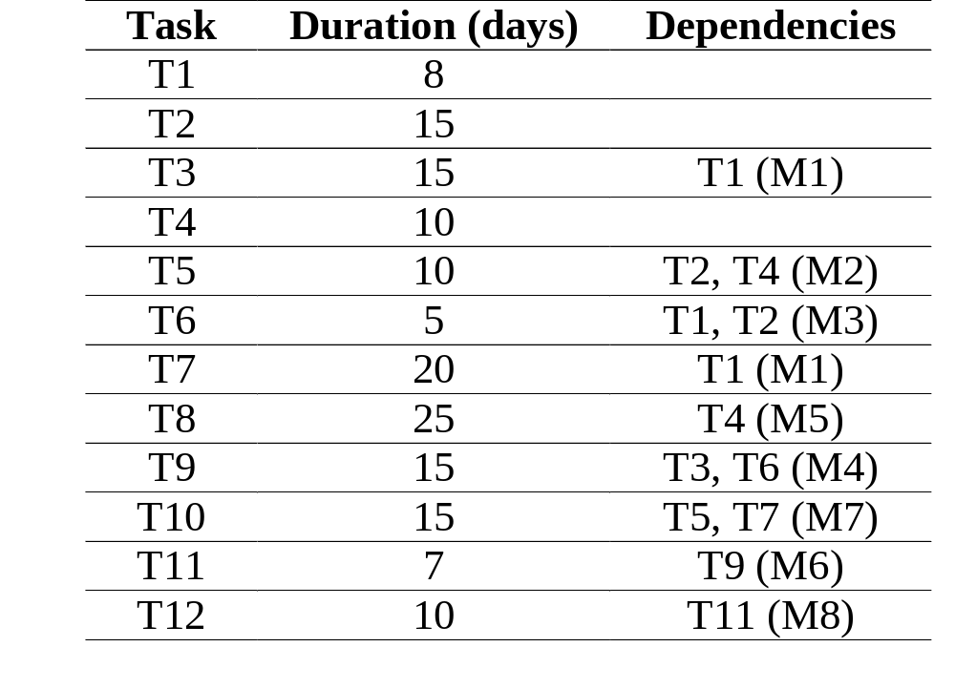
Task Duration & Dependency Table
MX = Milestone X
TX = Task X
T3 is dependent on T1, so T1 must be completed before T3 starts.

Slide 74
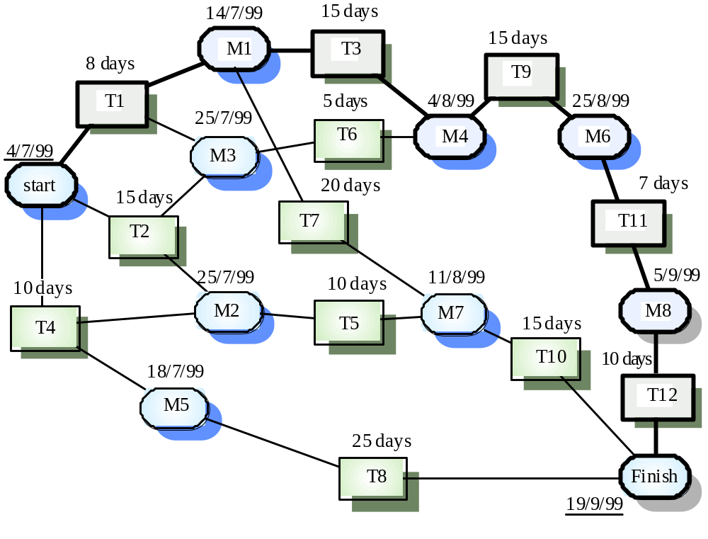
An Activity Network
Figure 1. Activity Network

Slide 75
Why is risk management employed?
It increases the probability of success of the project.
It is important that the project manager
  anticipates any risks that may affect
    the project schedule,
    the quality of the software being developed, or
    the organisation that is developing the software
  Takes steps to mitigate against these risks

Slide 76
Why is risk management employed cont’d?
Risk may arise from:
  loosely defined requirements
  difficulties in estimating the time and/or resources needed for the software development
  dependence on individual skills
  rapidly changing requirements due to changing customer needs

Slide 77
What does a risk management process look like?
Risk
Identification
Risk
Analysis
Risk
Planning
Risk
Monitoring
List of potential risks
Prioritised risk list
Risk avoidance and contingency plans
Risk
Assessment

Slide 78
What does a risk management process look like cont’d?
Risk Identification - Possible project, product and business risks are identified.
Risk analysis -The likelihood and consequences of these risks are assessed
Risk Planning - Plans to address the risk (avoidance or minimising) are drawn up.
Risk Monitoring - The risk is constantly assessed and plans for risk mitigation are revised as more information about the risk becomes available

Slide 79
Software Production
Different organisations have different ways of producing software. However there are basic criteria which may be used to compare the different organisations.
  Software Documentation Standards
  Intensity of Testing
  Maintenance

Slide 80
Software Production Difficulties
The difficulty with software production on the whole can be roughly divided into two categories
  accidents
  essence
    Essence refers to the difficulties that are inherent to the software production and cannot be changed.

Slide 81
Use the Quiz for a Quick Recap
Do you want a quick recap? Why not use the quiz?
  Use either the immediate feedback version
    Provides a correct or incorrect message response after each question
  Or, the non-immediate feedback version

Slide 82
Which of the following is a project function?
Project Management Quiz
Question 1
A
Software development
B
Software maintenance
C
Testing
D
Project schedule creation
Peek
Click Peek to lookup the answer in the notes.
Skip

Slide 83
A unit of work that has identifiable beginning and ending states is:
Project Management Quiz
Question 2
A
A task
B
An activity
C
Both of the above
D
A milestone
Peek
Click Peek to lookup the answer in the notes.
Skip

Slide 84
A deliverable is a milestone but a milestone is not necessarily a deliverable
Project Management Quiz
Question 3
A
True
B
False
Skip

Slide 85
Which of the following was not a characteristic of the software crisis?
Project Management Quiz
Question 4
A
Late delivery of software
B
Functional flaws
C
Incompetent managers
D
Over budget project
Peek
Click Peek to lookup the answer in the notes.
Skip

Slide 86
The project manager is responsible for:
Project Management Quiz
Question 5
A
Setting the project objectives
B
Monitoring the project
C
Supervising project work
D
All of the above
Skip

Slide 87
It is essential for a project manager to be well spoken and a great writer.
Project Management Quiz
Question 6
A
True
B
False
Skip

Slide 88
A specification document should not include
Project Management Quiz
Question 7
A
The mean time between failure
B
The test plan
C
The problem definition
D
All of the above
Peek
Click Peek to lookup the answer in the notes.
Skip

Slide 89
A solution strategy may specify the programming language that should be used
Project Management Quiz
Question 8
A
True
B
False
Skip

Slide 90
KDSI is unreliable because
Project Management Quiz
Question 9
A
Not all of the code is delivered to the customer
B
There is ambiguity in measuring it
C
It can only be determined when the product is finished
D
None of the above
Peek
Click Peek to lookup the answer in the notes.
Skip

Slide 91
Risk management is completed as follows …
Project Management Quiz
Question 10
A
Identification, planning, analysis and assessment
B
Identification, assessment, analysis and planning
C
Identification, planning, assessment and analysis
D
None of the above
Peek
Click Peek to lookup the answer in the notes.
Skip

Slide 92
Congratulations
You have successfully completed the quiz
Click here to see your report card

Slide 93
Reflective Question
Are good project managers made, not born?

Slide 94
Reflective Question
Can we plan for and avoid most types of risks?

Slide 95
Conclusions
In this session many important aspects of project management were discussed including:
  The software planning process and the contents of the software project management plan
  The software crisis
  The responsibilities of a project manager

Slide 96
References
Bauer, F. L. 1973. Software and Software Engineering. Society for Industrial and Applied Mathematics (SIAM) Review, 15 (2), pp. 469-480.
Schach, S. R. 2005. Object-Oriented & Classical Software Engineering. 6th ed. USA: Mc Graw Hill.
Sommerville, Ian. 2004. Software Engineering. 7th ed. USA: Addison Wesley.

